Slide 1
Grow Up! Evaluating and Maturing your SOC with MITRE ATT&CK

Slide 2
HI THERE!
Lauren Brennan
Team Lead, SOC Optimization
lauren.brennan@guidepointsecurity.com
6+ years Cyber Security Industry Experience
Worked in GRC, SOC Operations, and Risk
Cat mom, avid knitter, and book lover (350 read so far this year!)
Chat with me! @litwtch on Twitter (no I’m not calling it X), Mastodon, Threads, BlueSky, and all other social media sites

Slide 3
Why do you need to evaluate your SOC?
Understand where you excel currently and where you may have gaps in your technology stack and operations
Guide future planning and roadmaps
Understand your threats and how well you respond to them (before they happen!)
Align your operations across the organization and ensure all relevant business units are aware and processes work for all teams

Slide 4
The Pillars of SOC Foundations
Operations
The day-to-day function of a SOC, including leadership and analyst activities and how they work in real-world situations.
Procedures
The formal guidance meant to inform and dictate a SOC analyst's behavior during real-world situation.
Tooling
The technology and information supplied to a SOC analyst to support them during real-world situations.
Collaboration
The interactions within a SOC (analysts/tiers/leaders), the SOC and other parts of the organization (IT, Legal, PR), and the SOC with external service providers (MSP, Contractors).

Slide 5
SOC Assessment Workflow
1
2
3
4
Threat Actor Research & MITRE ATT&CK TTP Mapping
SIEM Detections Coverage Mapping
SIEM Detections Testing
End-to-End Use Case Review & Mapping

Slide 6
Where does MITRE ATT&CK Come into Play?
Standardize threat language across all pillars and business units
Visualize threats to the organization
Evaluate all pillars of your SOC

Slide 7
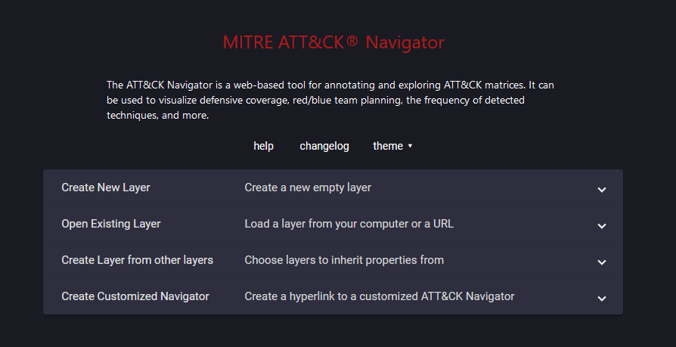
1
Identify Threats using ATT&CK
Operations Pillar of the SOC
Identify key threat actors (usually 5 – 10) that you are most concerned about
Look both internally and externally when developing this list
Example: Financial Industry Organization, concerned about admin@338, Indrik Spider, Lazarus Group, APT19, APT38, in addition to Ransomware and eCrime Groups (Exotic Lily, FIN7, TA505)

Slide 8
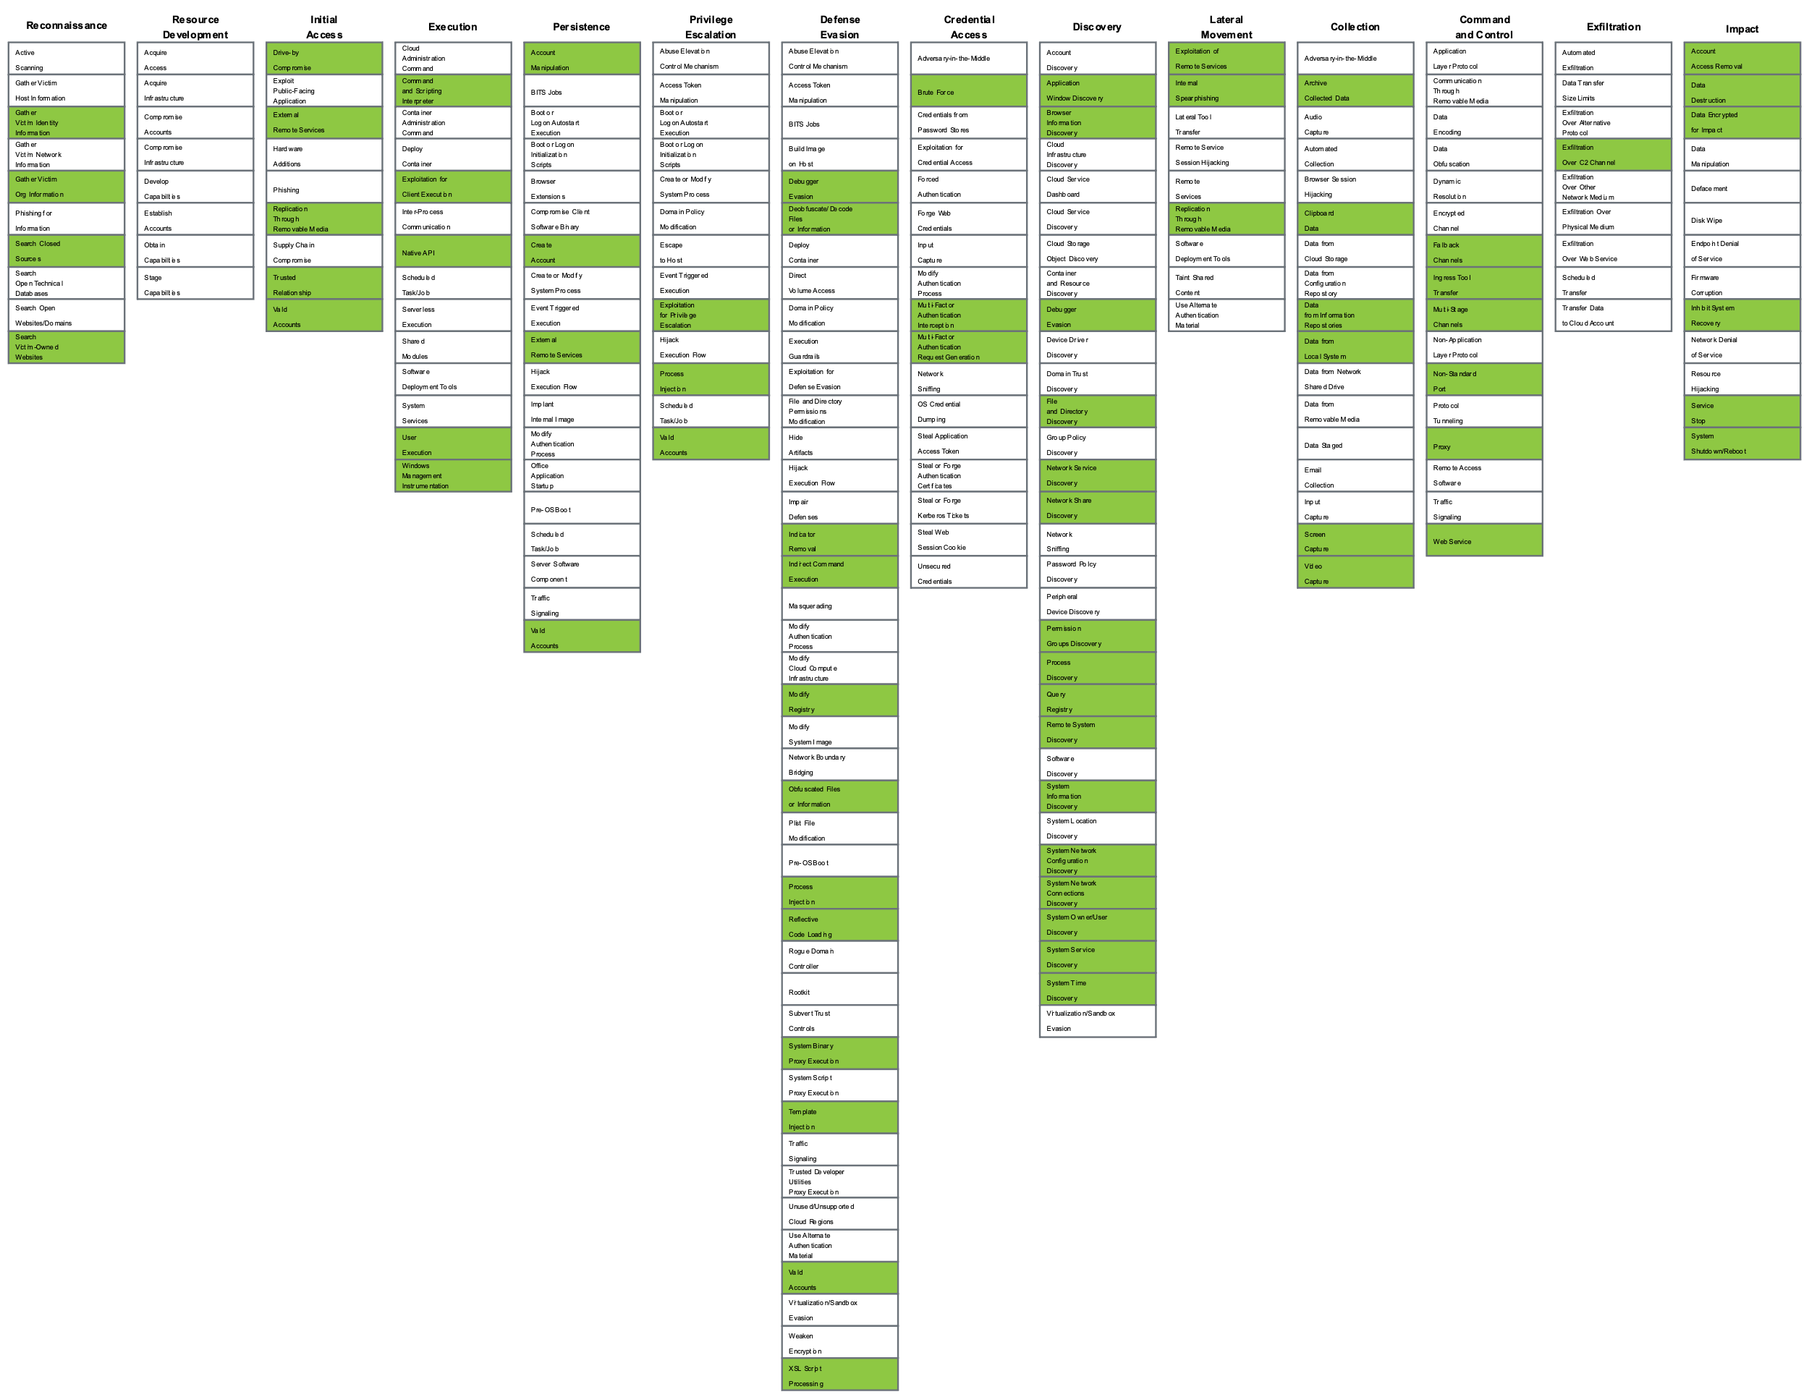
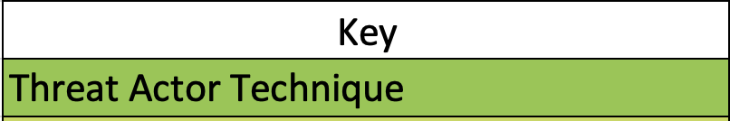
Example Navigator Mapping of Threat Actors

Slide 9
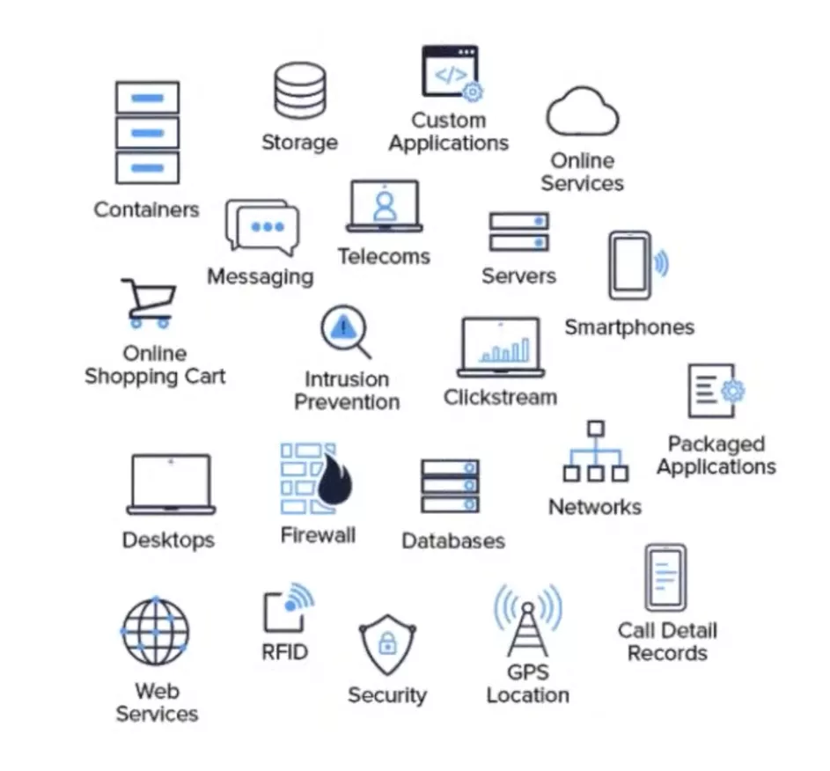
2
SIEM Detections Coverage Mapping (Detect Thy Enemy)
Technology Pillar of the SOC
Review your data sources AND your existing detection rules – are there any that aren’t currently coming into your SIEM?
Use Navigator to overlay your existing tech stack against the adversary mapped techniques
Look for any immediate gaps you notice in your technology stack that could affect your detections
Image source: https://www.crowdstrike.com/cybersecurity-101/observability/log-file/

Slide 10
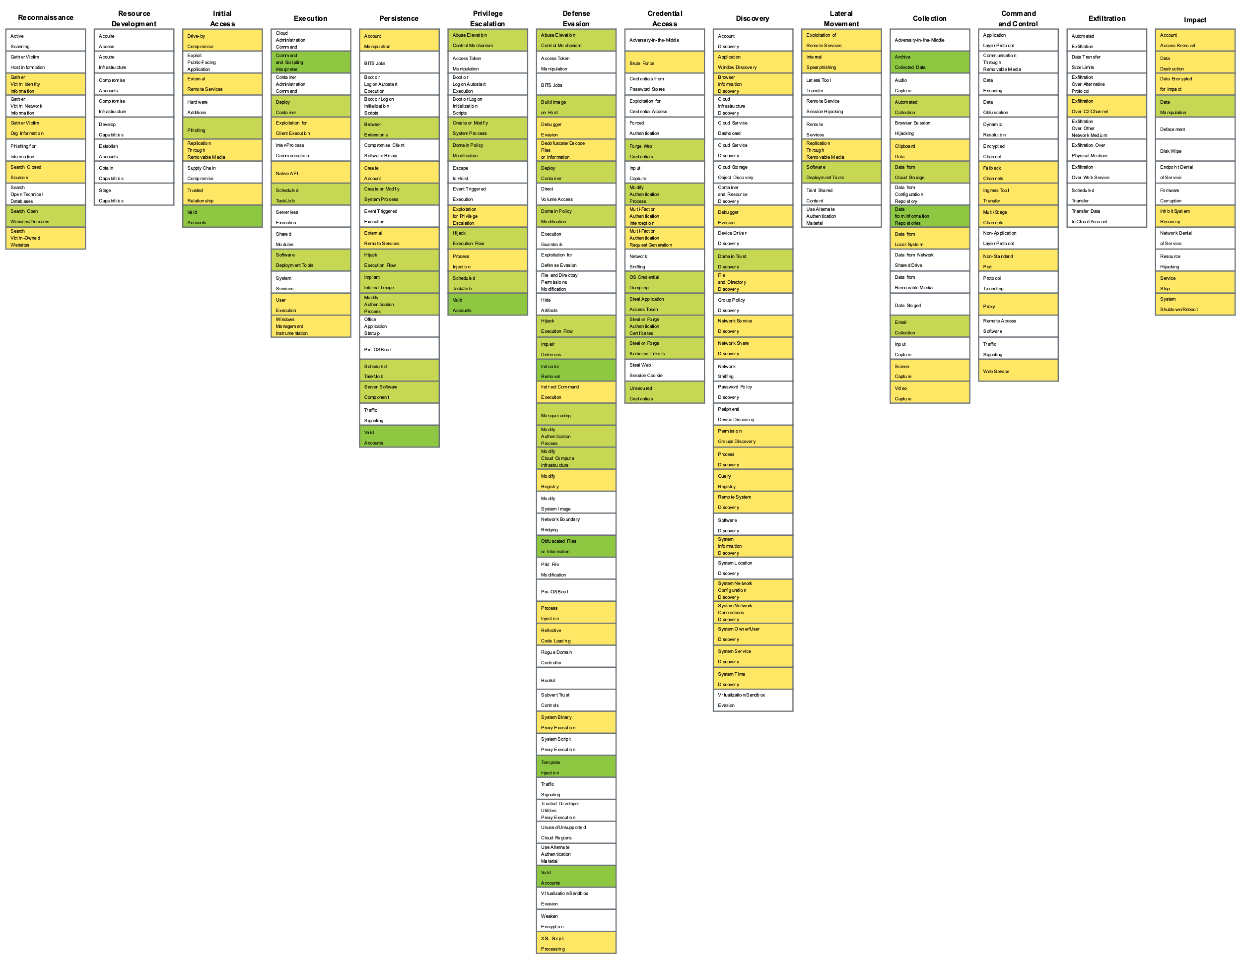
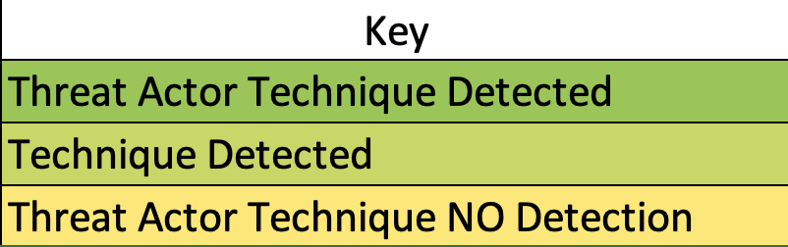
Example Navigator Mapping of TA Detections

Slide 11




3
Test! Test! Test! Your Detections
Technology + Operations Pillars of the SOC
Use open source (Caldera, Atomic Red Team) or paid tools (Mandiant, SightGain) to evaluate detection capabilities
If not possible to validate via testing - deep dive into the search language used for detections + review logs
Build new detections if you have detection gaps
Sigma rules and opensource detection sources can help you build new detections for gaps you identify

Slide 12
4
Workflow Analysis (Holistic Review)
Procedures + Collaborations Pillars of the SOC
Review current SOC/IR workflows
Map existing runbooks to enabled use cases, detections, and/or threat actor TTP’s to identify coverage and gaps in response capabilities
Runbooks (Response)
Detection and Alerting
Threat Actor TTPs
Evaluate:
Runbook Accessibility
Naming Conventions
Source Control

Slide 13
Putting it all together – How to Grow Up!
Review your existing coverage and the results of your tests
Evaluate and think about the other pillars of the SOC and how MITRE ATT&CK ties into the full process
Prioritize updating your detections based on the gaps in your MITRE coverage
Use MITRE ATT&CK as a measurement of your maturity
Use the language of MITRE ATT&CK to standardize your roadmap and measure your technical maturity on a regular basis

Slide 14
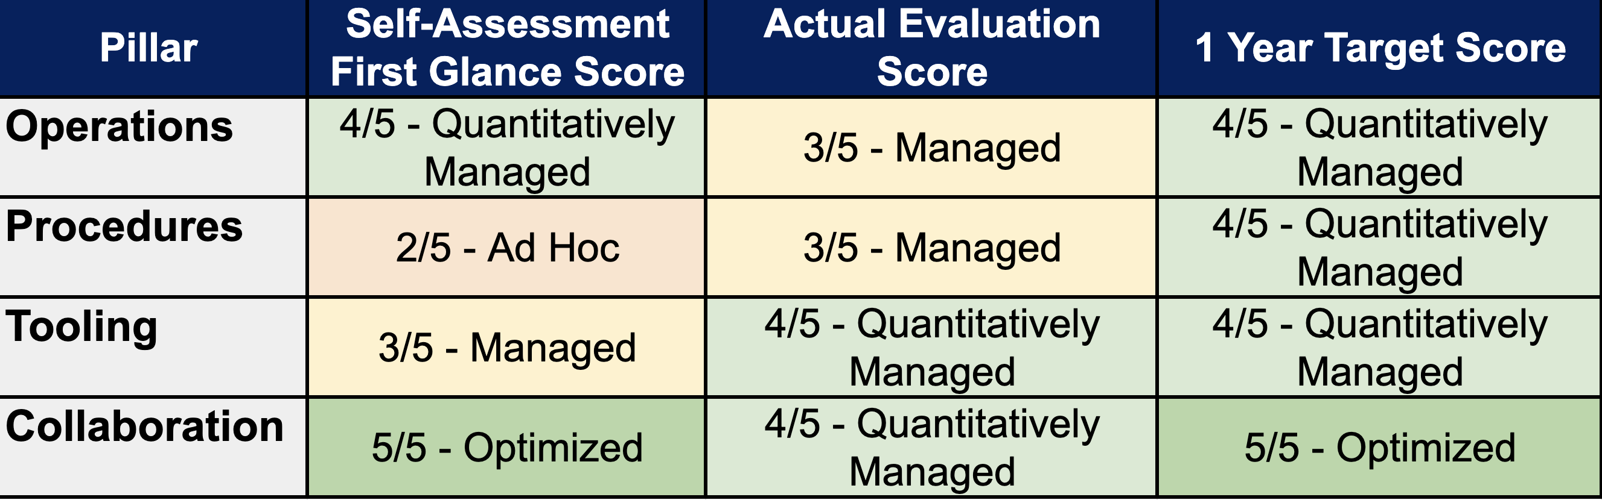
Example Assessment Score and Target

Slide 15
Example SOC Maturity Roadmap
4
3
2
1
0
Legend
0 – No Capability
1 – Initiating
2 – Ad Hoc/Defined
3 – Managed
4 – Quantitatively Managed
5 – Optimizing

Slide 16
Grow Up! The Value of Using MITRE ATT&CK
Build a roadmap for future improvement and utilize MITRE ATT&CK as a measurement for measuring success
Identify gaps in your existing technology stack and processes
Validate your existing detections and SOC/IR Processes
MITRE ATT&CK provides a standardized language for thinking about security operations in your organization

Slide 17
Q & A
Thank You!

